Slide 1
Data 621 Final Project Research Proposal Can we predict the quality of wine using data analysis techniques?
Critical Thinking Group 1
Slides organized by Jun Pan

Slide 2
Introduction
Vinho Verde wine exclusively produced in the demarcated region of Vinho Verde in northwestern Portugal. It is only produced from the indigenous grape varieties of the region, preserving its typicity of aromas and flavors as unique in the world of wine.
There are many psychochemical tests involved behind the quality of wine. Our goal is to predict the wine quality based on various psychochemical tests.

Slide 3

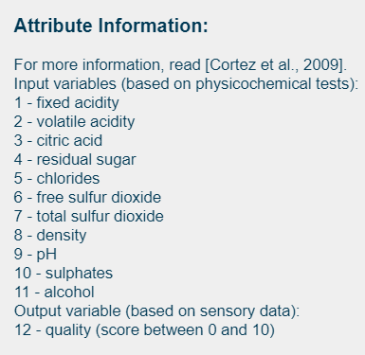
DATA Source
Got from UCI machine learning repository
(https://archive.ics.uci.edu/ml/datasets/Wine+Quality)
Two datasets were built based on red and white vinho verde wine samples from the north of Portugal.

Slide 4
Exploring the Data
First, I will load the required libraries and import the data into R directly from the UCI website. Red and white wine each have their own dataset and will be fully analyzed separately.
Secondly, we merge the two wine data base together and created a new column type.
Then, regression model will be built in the merged database (wines) as well as red wines and white wines databases.

Slide 5
For Each Dataset We will explore for
a. Mean / Standard Deviation / Median
b. Bar Chart or Box Plot of the data
c. Is the data correlated to the target variable (or to other variables?)
d. Are any of the variables missing and need to be imputed “fixed”?

Slide 6
DATA PREPARATION
a. Fix missing values (maybe with a Mean or Median value)
b. exclude the outliers
c. Mathematical transforms such as log or square root
d. derive variables (create new variables based on the original vairables)

Slide 7
Select Predictors
(1) Manual selection based on correlations (2) Automatic feature selection

Slide 8
Build models on merged wine dataset
Three types of models will be used:
(1) Linear regression model with all attributes
(2) Linear regression model with (volatile.acidity, chlorides, total.sulfur.dioxide, , free.sulfur.dioxide, pH, sulphates, alcohol)
(3) Linear regression model with (volatile.acidity, chlorides, total.sulfur.dioxide, pH, sulphates, alcohol)

Slide 9
Model Selection
Confusion matrix
ROC, AUC curves
ANOVA
Compare Residual, Sensitivity and Specificity
Linear regression with repeated 10-fold cross validation

Slide 10
Build models on white wines and red wines separately
Three types of models will be used
(1) k-nearest neighbours
(2) support vector machine
(3) random forest.
Training will be done with the help of the caret package’s train function. The cross-validation method will be 5 fold, repeated 5 times.

Slide 11
Model Selection
The models were trained using the accuracy metric.
Kappa is important as well and we will take that into account when evaluating model performance.
As a benchmark, we will use the results published in an academic study. We will find the model performed better than benchmark accuracy.

Slide 12
Discussion
Based on the model selection, discuss the cons and pros of each model.

Slide 13
Preliminary Analysis
Merged Wines(red wine + white wine)

Slide 14
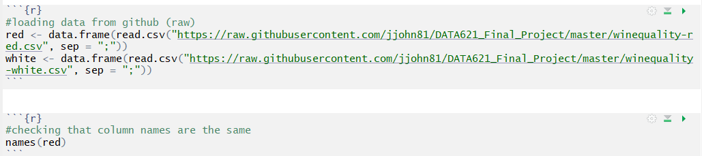
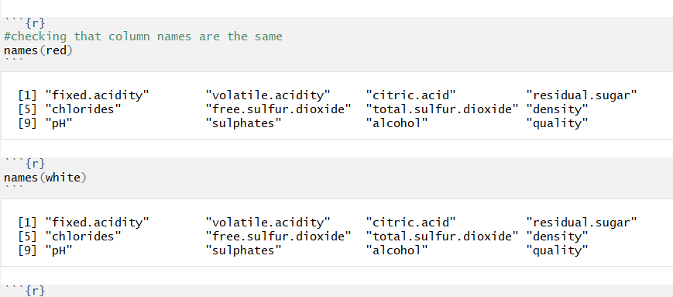
Load red wine and white wine data Check variable names

Slide 15
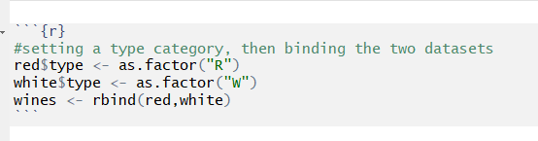
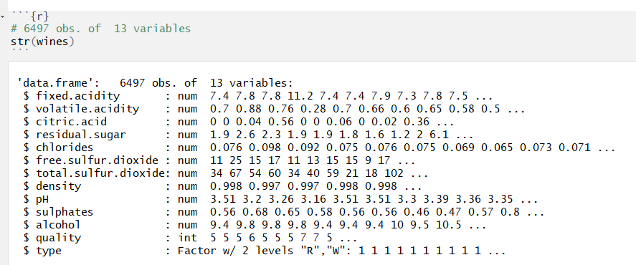
Merge the red win and white wine database Show structure of database

Slide 16
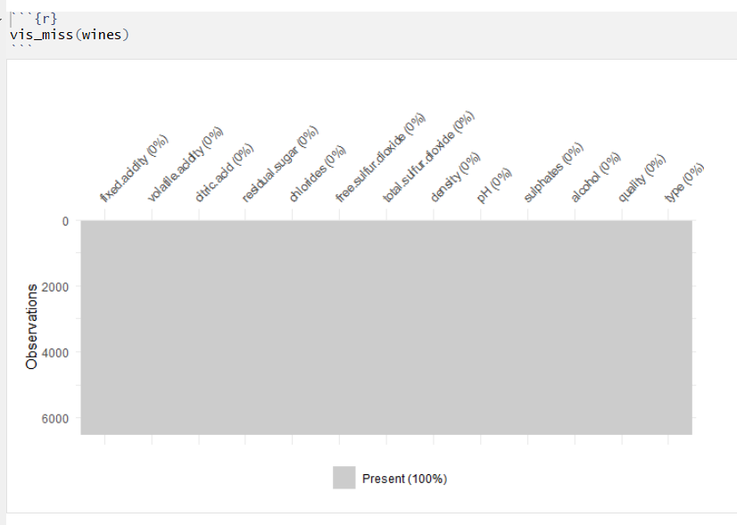

Slide 17
So far, we do not have missing data. We finished data exploration.
Then, we merge the two wine data base together and created a new column type. So we finish the data transformation.
According to our regular assignment. The first two parts have been finished.
Then, we need to create at least three prediction models.
The last we, we have to compare the different prediction models.

Slide 18
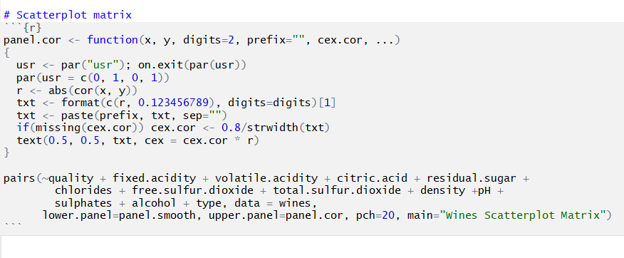
Correlation Matrix

Slide 19
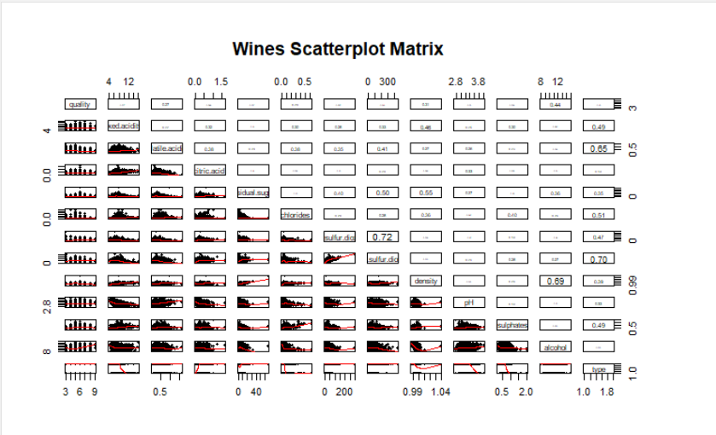

Slide 20
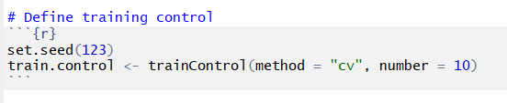
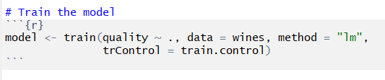
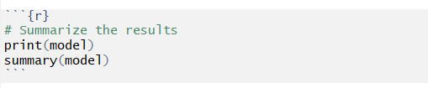
Linear Regression with Repeated 10-fold cross validation
Reference: http://www.sthda.com/english/articles/38-regression-model-validation/157-cross-validation-essentials-in-r/

Slide 21
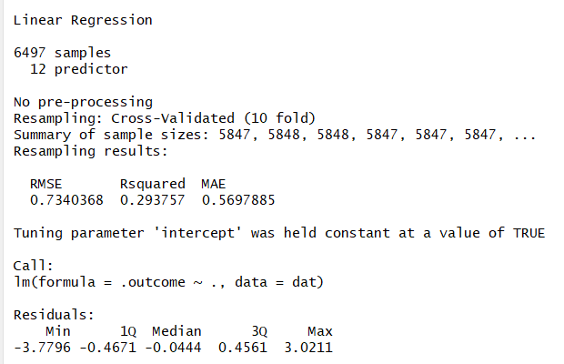

Slide 22
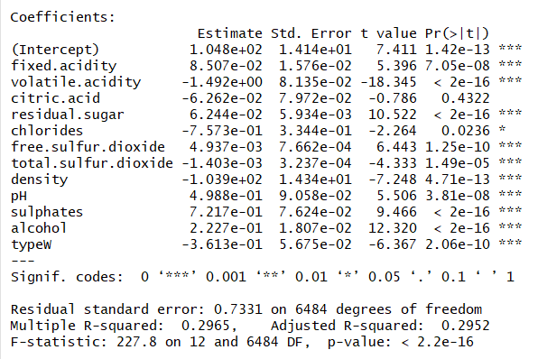

Slide 23
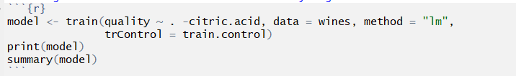
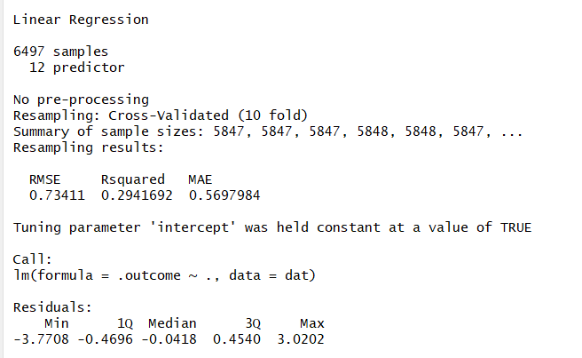
Because there is no effect on citric acid concentration in previous model, we removed this attributes in the new model

Slide 24
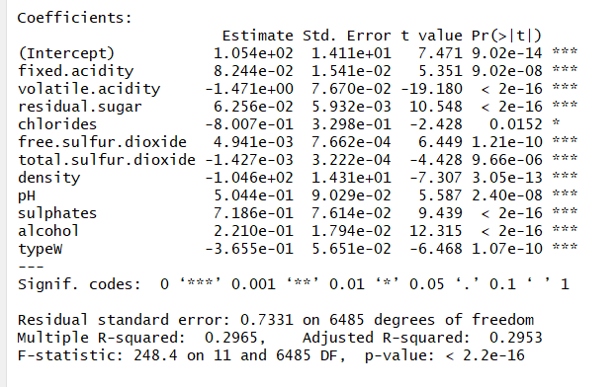

Slide 25
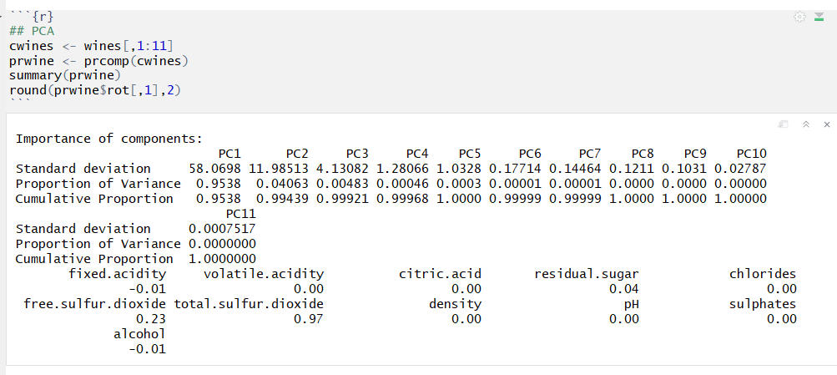
Further prove that citric acid does not contribute to wine quality

Slide 26
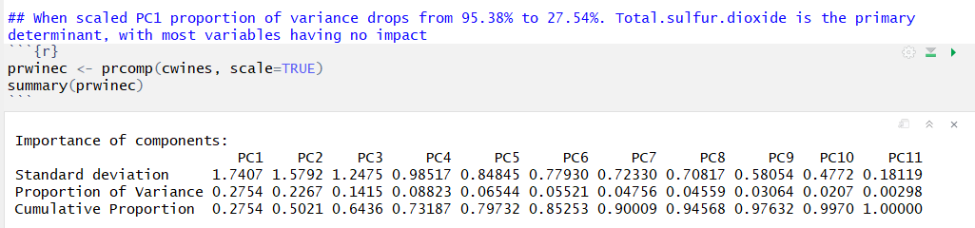
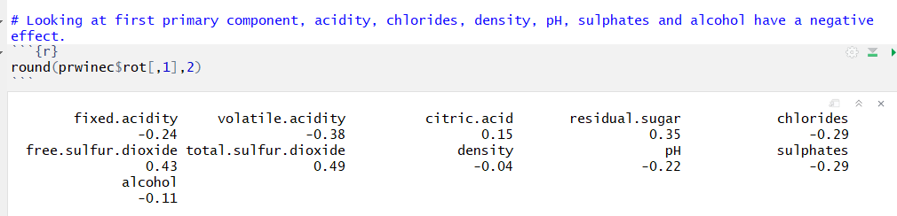

Slide 27
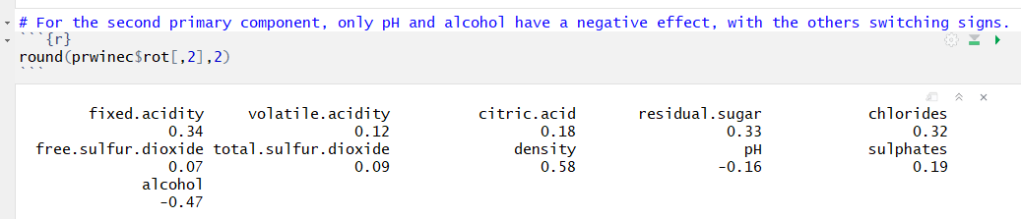
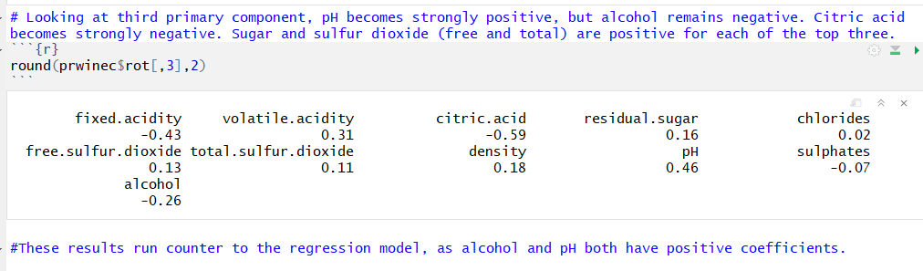

Slide 28
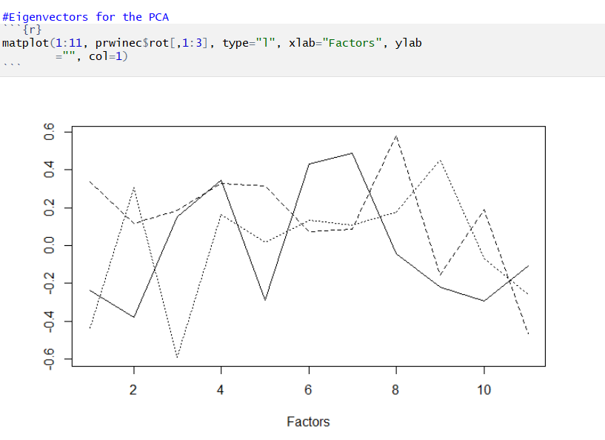

Slide 29
Analysis red wine and white wine separately
In this model, we analyzed the data by the type of wine (white or red).

Slide 30
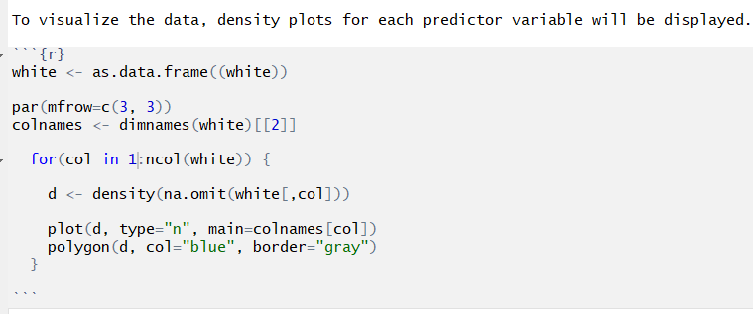
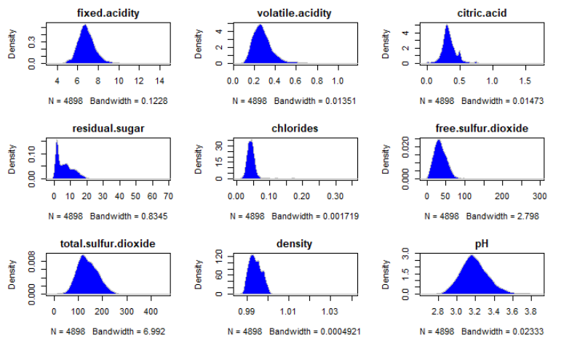
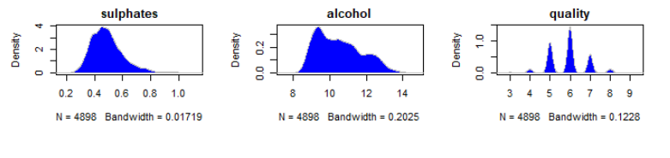
White Wine

Slide 31
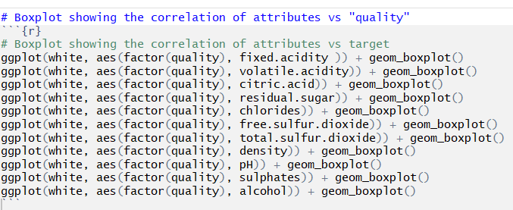
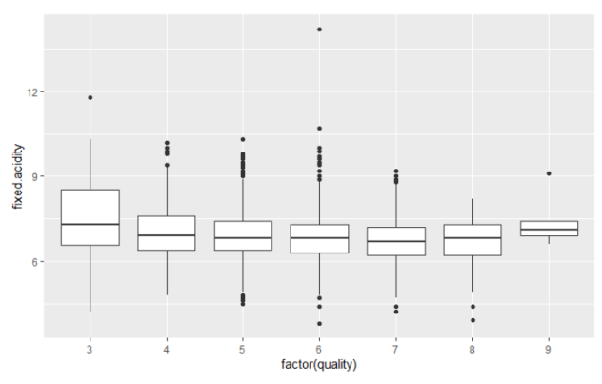
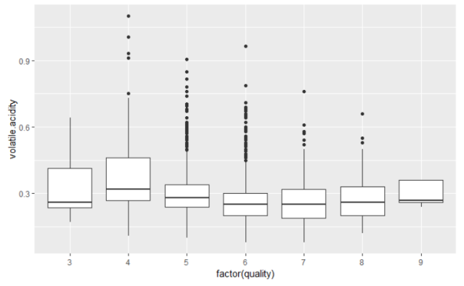
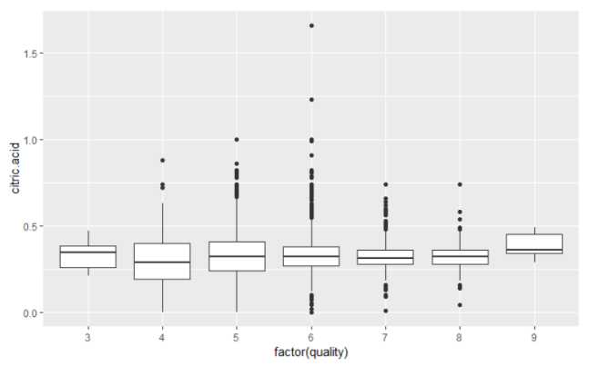
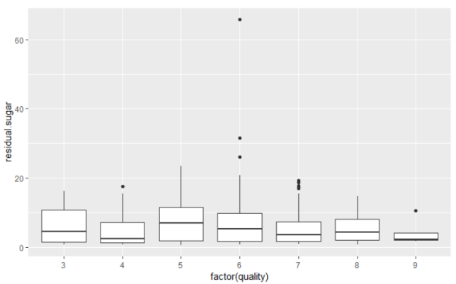
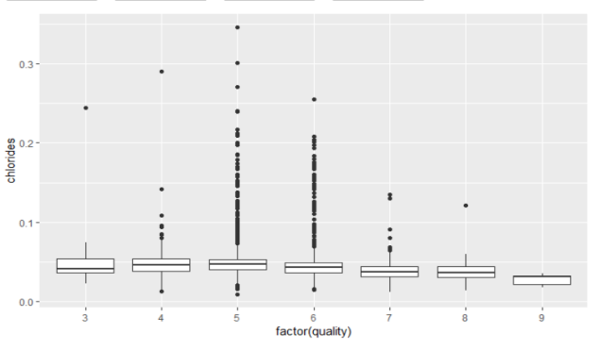
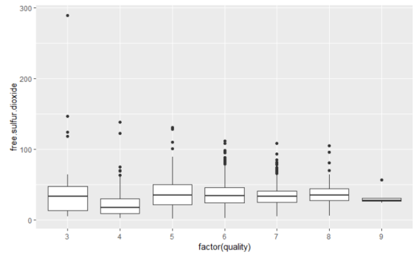

Slide 32
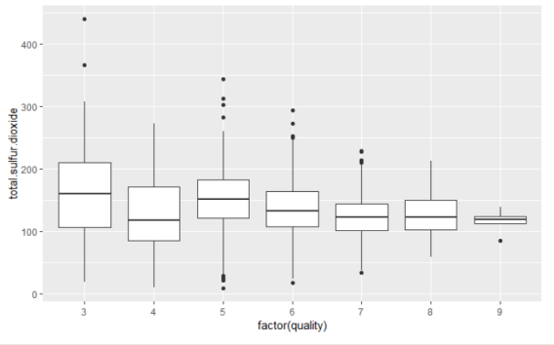
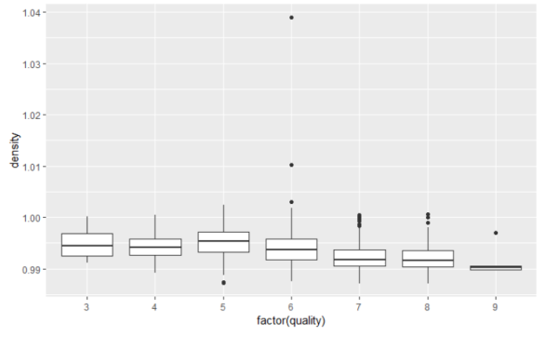
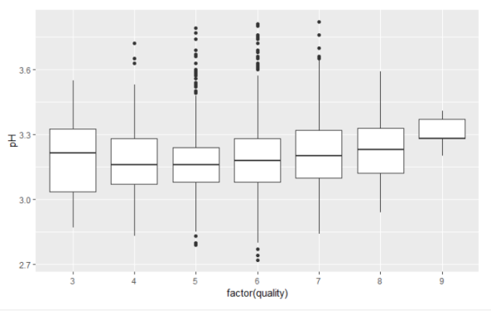
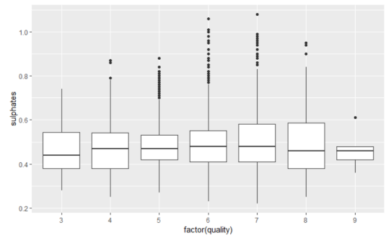
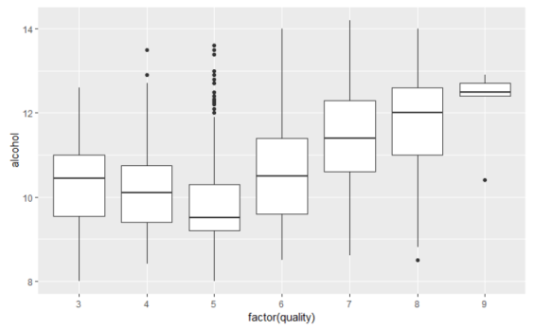
In the EU, a wine with more than 45g/l of sugar is considered a sweet wine. The outlier has a residual.sugar level of 65.8. The next highest sugar level in the dataset is 31.6. So we considered 65.8 as an outlier. It was removed from data base for further analysis.

Slide 33
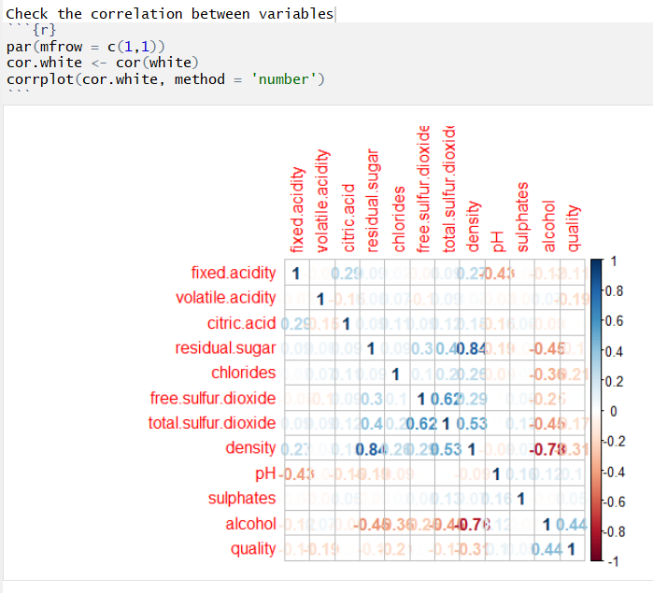

Slide 34
Explanation of correlation chart
We can see the residual sugar and density are highly correlated with each other. Both of them are negatively correlated with quality.
Free sulfur dioxide and total sulfur dioxide are highly correlated with each other. Both of them negatively correlated with quality.
Alcohol is positively correlated with quality. On the other hand chlorides are negatively correlated with quality.

Slide 35
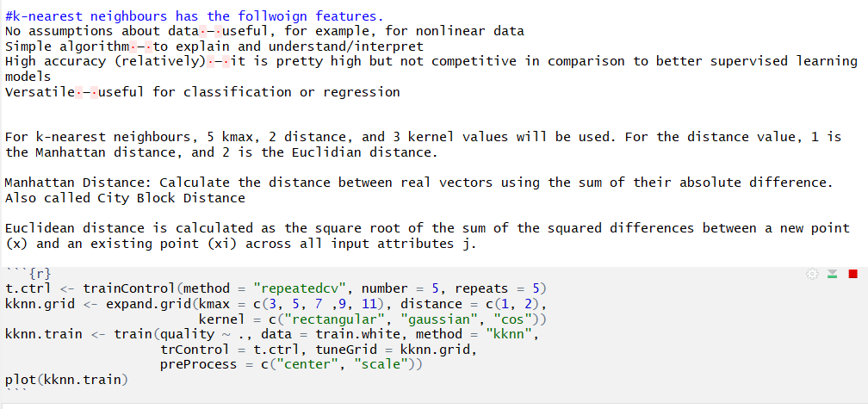
Building Model

Slide 36
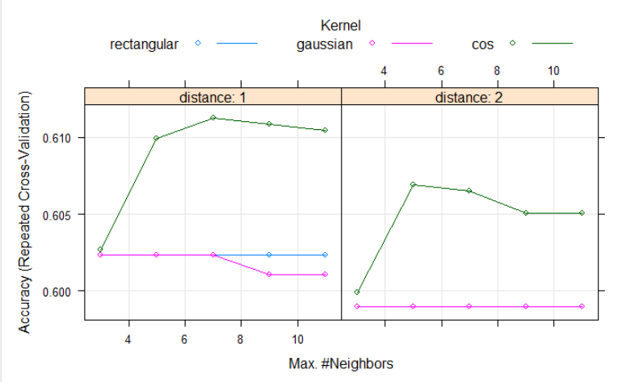
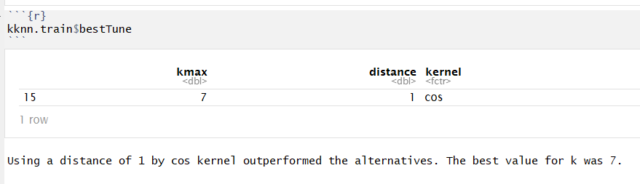

Slide 37
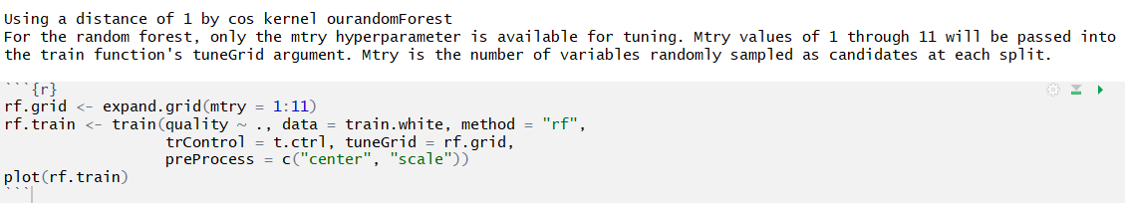
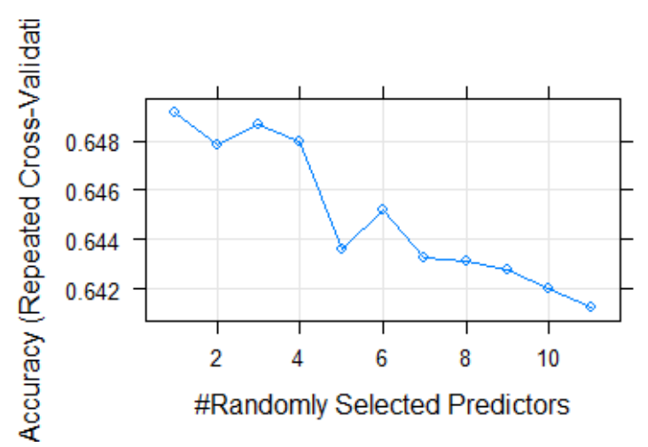

Slide 38
